Slide 1
Writing Kinect Programs
Using Sound with Kinect
Section 2.3

Slide 2
Topics
The Kinect microphone array
Connecting to the Kinect audio source
Storing audio data in a program
Playing audio in XNA

Slide 3
The Kinect sensor microphones
The Kinect sensor contains four microphones
These are spaced out along the sensor bar
The sensor also contains Digital Signal Processing (DSP) hardware that can refine the signal to discard background noise
The multiple microphones are not used for multi-channel audio input

Slide 4
Microphones and sound sources
Sound arrives at slightly different times at the Kinect sensor
By analysing the signals the Kinect sensor can determine the direction the sound is coming from
It can also discard sounds from other directions

Slide 5
The Kinect audio source
The Kinect audio hardware provides 16,000 samples a second
Each sample is a 16 bit value
This is not High Fidelity,
A music CD uses over 44,000 samples a second
The Kinect audio signal is perfect for high quality voice communication

Slide 6
Creating a Kinect Parrot
We are going to create a program that will work in the same way as a parrot
You can record a sound sample and play it back
The program will work as an XNA game
To make it work we will have to record audio from the Kinect, store it in memory and then play it back

Slide 7
The Kinect Parrot state
enum ParrotState
{
idle,
recording,
playing
};
ParrotState state;
This type will hold the state of the Parrot program

Slide 8
Implementing a state machine
protected override void Update(GameTime gameTime)
{
switch (state) {
case ParrotState.idle: updateIdle();
break;
case ParrotState.recording: updateRecording();
break;
case ParrotState.playing: updatePlayback();
break;
}
}
Update calls the appropriate state method

Slide 9
The idle state
When the program is in the idle state it is just waiting for a command to record or playback
The command are selected by two buttons or keys
A button/key start playback
B button/key start record
The updateIdle method checks to see if either of these keys has been pressed

Slide 10
Detecting keypresses
GamePadState oldPadState;
GamePadState padState;
KeyboardState oldKeyState;
KeyboardState keyState;
A keypress is registered when the state of a key changes from up to down
The Update method keeps these variables up to date for the use of other methods

Slide 11
The updateIdle method
void updateIdle()
{
if (oldKeyState.IsKeyUp(Keys.A) && keyState.IsKeyDown(Keys.A))
startPlayback();
if (oldKeyState.IsKeyUp(Keys.B) && keyState.IsKeyDown(Keys.B)))
startRecording();
}
The updateIdle method checks for key events and calls the appropriate methods

Slide 12
Recording Audio
When the program starts to record audio it connects to the Kinect sensor fetches sound data from it
The data is stored in the program
When the recording is finished the game returns to the idle state
The startRecording method sets up the recording

Slide 13
Storing sound data
const int bufferSize = 50000;
byte[] soundSampleBuffer = new byte[bufferSize];
Sound data from the Kinect can be stored in an array of byte values
A single sound sample value will be stored in two bytes in the array
The above array can store 25,000 samples

Slide 14
Capturing Sound using Kinect
The Kinect for Windows SDK contains a KinectAudioSource class that manages the sound output from the sensor
An instance of this class is exposed by the AudioSource property of a KinectSensor instance
Programs can configure the audio capture process and connect to an audio stream

Slide 15
Reading sound data
The sound data is supplied to the program via a Stream
A Stream is a software construct for transferring data into or out of a program
Programs call methods on a Stream instance to send or receive data
The KinectAudioSource type can provide a Stream that delivers audio data each time the program reads from it

Slide 16
Creating a Kinect Audio stream
Stream kinectAudioStream;
...
kinectAudioStream = myKinect.AudioSource.Start();
myKinect.Start();
This creates an instance of the KinectAudioStream class which will supply audio data
Note that the program must also start the Kinect sensor

Slide 17
Starting recording
Stream kinectAudioStream;
void startRecording()
{
kinectAudioStream = myKinect.AudioSource.Start();
state = ParrotState.recording;
message = "Recording";
}
This method starts recording
It makes a new audio source and then connects to the stream it provides

Slide 18
Starting recording
Stream kinectAudioStream;
void startRecording()
{
kinectAudioStream = myKinect.AudioSource.Start();
state = ParrotState.recording;
message = "Recording";
}
The Start method returns the stream that delivers audio data

Slide 19
The updateRecording method
void updateRecording()
{
kinectAudioStream.Read(soundSampleBuffer, 0, soundSampleBuffer.Length);
kinectSource.Stop();
message = "Press A to playback B to record again";
state = ParrotState.idle;
}
This method updates the game when the recording state

Slide 20
Reading from the audio stream
void updateRecording()
{
kinectAudioStream.Read(soundSampleBuffer, 0, soundSampleBuffer.Length);
kinectSource.Stop();
message = "Press A to playback B to record again";
state = ParrotState.idle;
}
This call reads audio from the Kinect until the buffer has been filled up

Slide 21
Stopping the audio stream
void updateRecording()
{
kinectAudioStream.Read(soundSampleBuffer, 0, soundSampleBuffer.Length);
kinectSource.Stop();
message = "Press A to playback B to record again";
state = ParrotState.idle;
}
This stops the audio stream from producing any more data

Slide 22
Returning to the idle state
void updateRecording()
{
kinectAudioStream.Read(soundSampleBuffer, 0, soundSampleBuffer.Length);
kinectSource.Stop();
message = "Press A to playback B to record again";
state = ParrotState.idle;
}
These statements update the prompt message on the screen and return the program to the idle state

Slide 23
Threads and XNA
This version of updateRecording is not very well written
It will pause the game update calls while the audio is recorded
This would cause the screen to pause during recording
A better design would be to start a thread off that performs the recording in the background

Slide 24
Playing back data
Once the audio has been captured the next thing is to play it back
The XNA framework provides a number of types that can play sounds
The one we are going to use is the DynamicSoundEffectInstance
This can be given a buffer of sound values to play back

Slide 25
Dynamic Sound Playback
The XNA SoundEffectInstance and SoundEffect classes can be used to play back sounds loaded from sound assets that have been loaded into the game
The DynamicSoundEffectInstance can be given an array of sound values which it will play back
It can play back sound in a variety of formats, including the produced by Kinect

Slide 26
Creating a playback sound effect
DynamicSoundEffectInstance playback = new DynamicSoundEffectInstance(16000, AudioChannels.Mono);
This DynamicSoundEffectInstance is configured to play the stored sound data directly
The first parameter to the constructor is the sample rate (16000 samples a second) and the next parameter is the audio format

Slide 27
Starting playback
void startPlayback()
{
playback.SubmitBuffer(soundSampleBuffer);
playback.Play();
message = "Playing";
state = ParrotState.playing;
}
The SubmitBuffer method sets the sample buffer to be played back
The Play method starts the playback

Slide 28
Updating playback
void updatePlayback()
{
if (playback.PendingBufferCount == 0)
{
message = "Press A to playback B to record again";
state = ParrotState.idle;
}
}
The updatePlayback method checks to see if playback has finished

Slide 29
Updating playback
void updatePlayback()
{
if (playback.PendingBufferCount == 0)
{
message = "Press A to playback B to record again";
state = ParrotState.idle;
}
}
If there are no bytes left to play the method returns the state of the game to idle

Slide 30
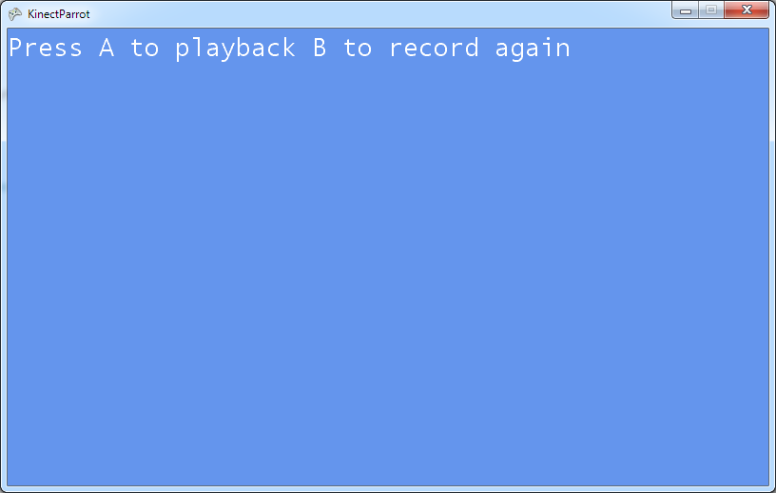
Demo
1 Kinect parrot
Notes:
For this demonstration to work you must have installed the Kinect for Windows SDK. You must also have a Kinect sensor plugged into the USB Port on your computer.
Start Visual Studio 2010
Open the project KinectParrotin the 01 Kinect Parrot demo folder.
Run the program by pressing F5.
The program will start running. Press B (on gamepad or keyboard) to record a message)
Press A to play back the message.
Move the left thumbstick all the way to the left.
Press A again to play the message.
Ask what just happened.
Answer: The message was played at a much lower pitch.
Ask how this could work
Answer: The sound effect playback speed can be modified.
Open the KinectParrotGame.cs source file.
Navigate to the updatePlayback method.
Show how if the sound sample is playing the playback pitch of the soundeffect is varied by using the left thumbstick.
Make the point that the sound playback speed can be varied during playback using this method.
Stop the program and exit Visual Studio.

Slide 31
Changing the pitch of a sound
playback.Pitch = padState.ThumbSticks.Left.X;
XNA allows a program to change the pitch of a sound effect as it is playing
The statement above uses the X position of the left thumbstick to control the pitch
A program can also control the volume and the left-right position of the sound

Slide 32
Summary
The Kinect sensor bar holds four high quality microphones
These are not for multi-channel sound but so the Kinect sensor can isolate sounds, particularly speech
To record sound in Kinect you use the KinectAudioSource class
Sound is sampled 16,000 times a second, producing 16 bit values which can be stored in a byte array
Stored data can be played back by a XNA program by using the DynamicSoundEffectInstance class

